Slide 1
Arrays
CSCI 2010U - Data Structures

Slide 2
Outline
Arrays
Memory structure
Length vs. capacity
Unsorted arrays
Searching, insertion, and deletion
Sorted arrays
Searching, insertion, and deletion
Arrays
2

Slide 3
Memory Structure
Arrays are normally implemented using adjacent memory spaces
3 | 7 | 11 | 19 | 23 | 27 | 31 | 34
Arrays
3

Slide 4
Unsorted and Sorted Arrays
Depending on the situation, you may wish to keep your array elements sorted
This will impact the performance of various operations
Arrays
4

Slide 5
Unsorted Arrays - Searching
Searching in an unsorted array must use linear search
Linear search takes proportional to n time (n - array length) - O(n)
Search every space until found or the length is reached
Arrays
5
Notes:
The actual search time will vary for different lists and values to find. We could find the element at the start (examining just 1 element), or at the end (examining all n elements). How many elements will we examine on average?

Slide 6
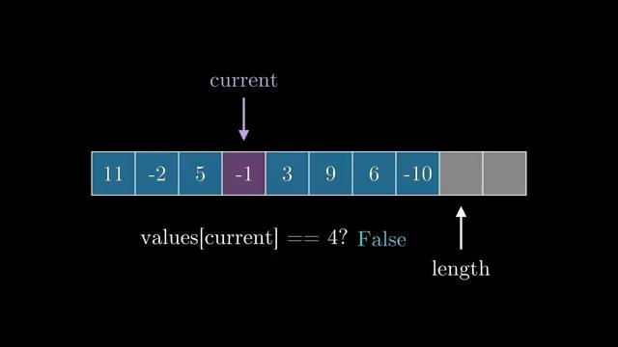
Unsorted Arrays - Searching
Arrays
6
Notes:
In this example, representative of the worst case, we have to examine all elements to determine that the value is not in our array.

Slide 7

Unsorted Arrays - Searching
Arrays
7

Slide 8
Unsorted Arrays - Insertion
Inserting into unsorted arrays can be anywhere
e.g. insert at the end (at index length)
Insertion at the end takes constant time - O(1)
Arrays
8
Notes:
We could also insert at the beginning, or somewhere in the middle of the array. What would the consequences be for choosing either of those options?

Slide 9
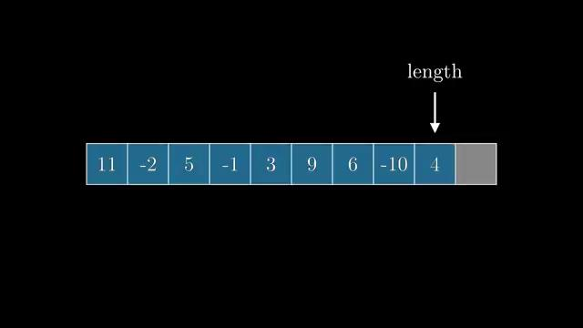
Unsorted Arrays - Insertion
Arrays
9

Slide 10
Unsorted Arrays - Deletion
Deletion from unsorted arrays requires removal of the empty space
Finding the element to be deleted takes time proportional to n - O(n)
Linear search
Deleting and removing the empty space takes time proportional to n - O(n)
Move all of the larger elements to the left by 1
Arrays
10

Slide 11
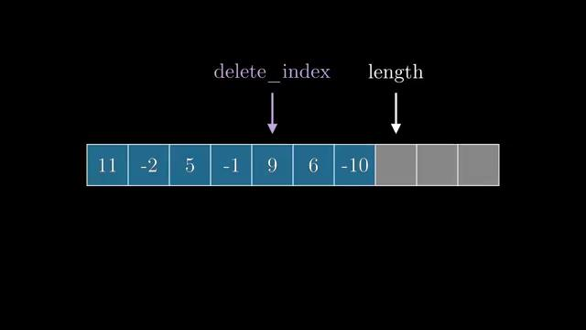
Unsorted Arrays - Deletion
Arrays
11

Slide 12
Sorted Arrays - Searching
Searching in a sorted array can use binary search
Binary search takes proportional to log₂n time - O(log n)
Check the middle element
If the value to find is equal to this middle element, success
If the value to find is less than this middle element, search the left half of the list
If the value to find is greater than this middle element, search the right half of the list
Arrays
12

Slide 13
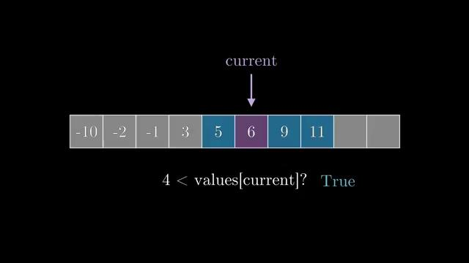
Sorted Arrays - Searching
Arrays
13

Slide 14
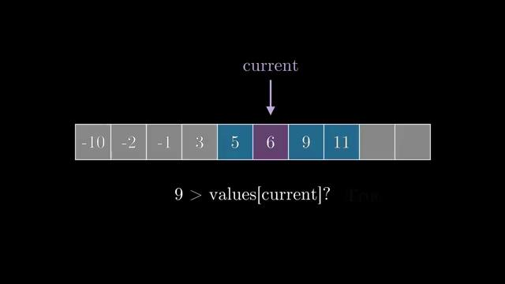
Sorted Arrays - Searching
Arrays
14

Slide 15
Sorted Arrays - Insertion
Inserting into sorted arrays must be in the proper position
Use binary search to find the insertion index - O(log n)
Move all larger elements to the right to make space - O(n)
Move the new element into the newly emptied space - O(1)
Insertion in sorted order takes proportional to n time - O(n)
Arrays
15

Slide 16
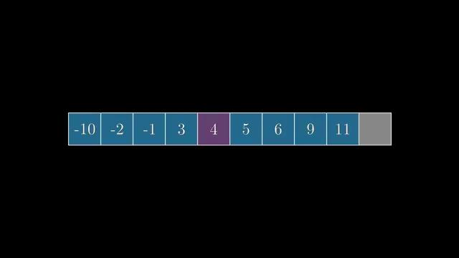
Sorted Arrays - Insertion
Arrays
16

Slide 17
Sorted Arrays - Deletion
Deletion from sorted arrays is similar, but not identical, to unsorted arrays
Use binary search to find the element to be deleted, takes time proportional to log₂n - O(log n)
Shifting all larger elements to the left takes time proportional to n - O(n)
Arrays
17

Slide 18
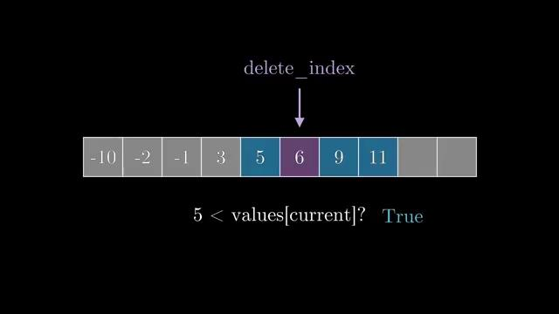
Sorted Arrays - Deletion
Arrays
18

Slide 19
Wrap-up
Arrays
Memory structure
Length vs. capacity
Unsorted arrays
Searching, insertion, and deletion
Sorted arrays
Searching, insertion, and deletion
Arrays
19

